Slide 1
Synchronization
Week 6

Slide 2
Synchronization as a Concept
Synchronization means coordinating processes and threads that run at the same time
They may compete for the same resource, get in each other's way, or work together
Concurrent: more than one thread exists at once. Asynchronous: they run on their own, and only sometimes need to coordinate
Like coworkers sharing one printer, one kitchen, or one shared document

Slide 3
Race Conditions
A race condition happens when the result depends on who gets there first
Everyday examples:
  Two people buy the last concert ticket at the same moment, and the site sells it twice
  Two ATMs take money from the same account at once, and the balance ends up wrong
  Two people edit the same cell in a shared spreadsheet, and one change disappears
A context switch can happen at any moment, even in the middle of updating a value
The fix: make sure only one process changes shared data at a time

Slide 4
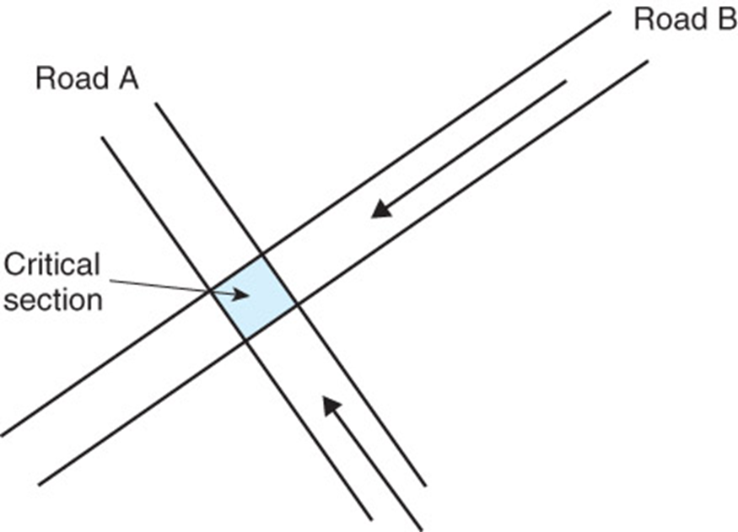
Example of a Critical Section
Two cars approach an intersection, one on Road A and one on Road B
If they get there at the same time, they crash
The intersection is part of both roads: a critical section. Only one car should be in it at a time
Traffic lights and stop signs provide mutual exclusion

Slide 5
Mutual Exclusion
Only one process at a time can use a shared resource
  Like a single-stall bathroom with a lock: one person inside, and everyone else waits
Without it, shared data can be left half-changed (inconsistent)
Others wait until the resource is unlocked, so access happens one at a time
Waits must stay reasonable, or nothing gets done
This is the most basic synchronization rule

Slide 6
Critical Section
A critical section is the part of a program that uses a shared resource
Most code is safe to run at the same time as other code, but the parts that change shared data must be protected
Only one thread can be in its critical section at once
Keep critical sections short. If a thread gets stuck inside one, everyone else is stuck waiting

Slide 7
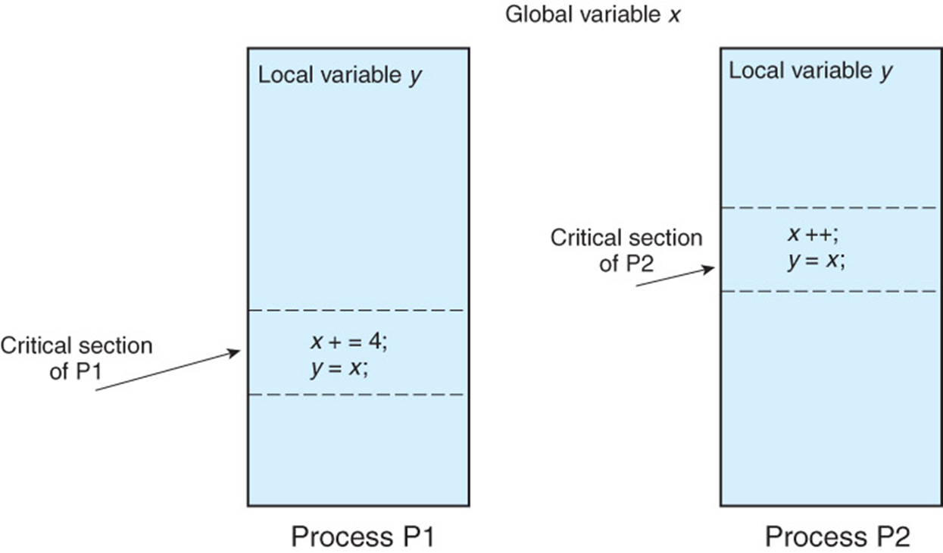
Critical Sections in Two Processes

Slide 8


Example of Critical Sections
Shared resource: Printer buffer
Two processes:
  Producer:
    produces a character,
    places the character in buffer.
  Consumer:
    Removes a character from the buffer,
    consumes the character.

Slide 9
The Critical Section Problem
Every process using a shared resource must follow the same rules (a protocol)
A good protocol gives:
  Mutual exclusion: only one process in the critical section at a time
  Progress: if no one is inside, someone waiting gets to go in
  Bounded waiting: no process waits forever
Like a four-way stop: one car at a time, someone always goes, and everyone gets a turn

Slide 10
Definition of a Critical Section Protocol
Entry section: check whether anyone else is in the critical section. If so, wait. If not, put up a "busy" sign and go in
Critical section: use the shared resource
Exit section: take the sign down, so someone waiting can go in
Like flipping the "occupied" sign on a bathroom door

Slide 11
Synchronization Solutions
Software solutions: rules the processes follow, using shared variables
Hardware solutions: special instructions built into the processor
  Faster, and they make the software simpler to write
Operating system tools build on these: locks, semaphores, and monitors

Slide 12
Software Solutions
Dekker's algorithm: the first correct solution for two threads
  Each thread raises a flag to say it wants in. If both want in, a "favored" thread goes first, and the favor takes turns
  It took several broken tries to get right, which shows how hard this is
Peterson's algorithm: a simpler version of the same idea
Lamport's bakery algorithm: works for any number of threads
  Like a deli counter: take a numbered ticket, and the lowest number goes next
All three waste CPU time by checking again and again (busy waiting)
Notes:
Leslie Lamport: The Writings of Leslie Lamport: https://lamport.azurewebsites.net/pubs/pubs.html

Slide 13
Disabling Interrupts
Turn off interrupts so the running thread can't be interrupted inside its critical section
Only works with one processor. On a multi-core system it only stops one core, and the others keep going (Week 4)
  Like putting your phone on Do Not Disturb: it silences your phone, not your roommate's
Can cause deadlock if the thread waits for I/O, because the I/O interrupt never gets through
Rarely used today

Slide 14
Test-and-Set Instruction
A special instruction that checks a value and changes it in one step that can't be interrupted (atomic)
  Like checking that a seat is empty and sitting down in one move, so no one can slip in between
Test-and-set: read a lock's value, and set it to "taken" at the same time
Today's processors offer compare-and-swap, and Linux builds its locks on it
The software still has to use these instructions correctly
Notes:
Linux kernel documentation: Generic Mutex Subsystem: https://docs.kernel.org/locking/mutex-design.html

Slide 15
Semaphores
A semaphore is a counter that controls access to a resource, like a traffic light
Only two operations can change it:
  Wait (P): if the count is above 0, subtract 1 and go. If it's 0, wait in line
  Signal (V): add 1, and let the next waiting process go
P and V come from Dutch words chosen by Edsger Dijkstra, who invented semaphores
The OS provides semaphores, so programs don't have to build their own
Notes:
E.W. Dijkstra: Cooperating sequential processes (EWD 123): https://www.cs.utexas.edu/~EWD/transcriptions/EWD01xx/EWD123.html
Linux manual page: sem_overview: https://man7.org/linux/man-pages/man7/sem_overview.7.html

Slide 16
Binary and Counting Semaphores
Binary semaphore: 0 or 1, so one process at a time
  Like the single bathroom key at a gas station: take it, use it, and bring it back
Counting semaphore: 0 or more, so up to that many processes at once
  Like a parking garage sign showing spaces left. When it reaches 0, the next car waits
  Or a print room with 3 printers: up to 3 jobs print at once
Binary semaphores give mutual exclusion: wait before the critical section, and signal after

Slide 17
Thread Synchronization with Semaphores
Semaphores can also tell other threads that something happened
Producer and consumer:
  The producer makes a value, then signals
  The consumer waits for that signal before reading the value
  The producer can't replace the value until it's been used
Like a restaurant: the cook puts a plate in the window and rings the bell, and the server waits for the bell

Slide 18
Monitors
A monitor bundles shared data with the only procedures allowed to use it
  Like a room with one door and a guard: only one person inside at a time, and everyone else waits in line
Mutual exclusion is enforced automatically at the door
A thread inside can wait for something to happen (a condition variable), stepping out so someone else can go in
Easier to use correctly than semaphores, because the rules are built in. Languages like Java build monitors in

Slide 19
Synchronization Case Studies
Classic problems that test a synchronization solution:
  Bounded buffer (producer and consumer)
  Readers and writers
  Dining philosophers
Each one shows up in real systems you use every day

Slide 20
Bounded-Buffer Problem
A producer adds items to a buffer with a fixed number of slots, and a consumer takes them out
Real examples:
  A print queue: your computer adds jobs, and the printer takes them out
  Video streaming: your device downloads ahead into a buffer while the player uses it up
The producer waits if the buffer is full, and the consumer waits if it's empty
Three semaphores solve it: a binary one to protect the buffer, one counting the full slots, and one counting the empty slots

Slide 21
Readers and Writers Problem
Many processes read shared data, and some write (change) it
Any number of readers can read at the same time
A writer needs the data to itself
Like a class schedule posted online: thousands of students can view it at once, but while the registrar updates it, nobody should see a half-changed version
The next slide shows the lock built for this

Slide 22
Read/Write Locks
A read/write lock has two modes:
  Shared (read) mode: many readers hold it at once
  Exclusive (write) mode: one writer holds it, and nobody else
Like a museum painting: crowds can look at it together, but a restorer works on it alone, with the room closed
Linux uses read/write locks inside the kernel
Notes:
Linux kernel documentation: Lock types and their rules: https://docs.kernel.org/locking/locktypes.html

Slide 23
Locks on Multiprocessors
Spin lock: keep checking until the lock is free
  Like standing at the bathroom door and trying the handle over and over
  Wastes CPU time, but reacts the instant the lock is released. Good for very short waits
Sleep/wakeup lock: waiting processes sleep, and the lock holder wakes the next one when it's done
  Like sitting in a waiting room until your name is called
Spin, then sleep: spin for a moment, then sleep if it's still taken. Linux's mutexes do this
Notes:
Linux kernel documentation: Locking lessons: https://docs.kernel.org/locking/spinlocks.html

Slide 24
The Thundering Herd
If every waiting process wakes up when a lock is released, they all rush for it, but only one can win
  Like a waiting room where everyone jumps up when one name is called
The rest go back to sleep, after wasting time and CPU
Sleep/wakeup locks avoid this by waking just the next process in line
Linux's futexes let programs lock and unlock without calling the kernel at all, unless they actually have to wait
Notes:
Linux manual page: futex: https://man7.org/linux/man-pages/man2/futex.2.html

Slide 25
Dining Philosophers
Five philosophers sit at a round table, with one chopstick between each pair
Each one needs both chopsticks next to them to eat
If everyone picks up their left chopstick at the same time, nobody can ever get a right one, and everyone waits forever
That's deadlock, next week's topic (Week 7)
It models any system where processes need more than one shared resource at once

Slide 26
Message Passing and Synchronization
Sending messages between processes also needs synchronization (Week 2)
Asynchronous: the sender leaves the message in a mailbox and keeps going. The receiver waits until a message arrives
  Like sending a text message
Synchronous: both processes take part at the same time, over a direct channel
  Like a phone call

Slide 27
Synchronization and Crashes
A bank transfer must take money out of one account and add it to another, as one atomic transaction
If the system crashes halfway, recovery must either finish the transaction or undo it
Systems use transaction logs and checkpoints for this, covered in the File Systems week
Most real systems use both: logs for everyday recovery, and checkpoints for disasters

Slide 28
Synchronization You've Seen
Print queues: many computers share one printer, one job at a time
Google Docs: several people type at once, and the system merges the changes so no one's work disappears
Ticket and shopping sites: the last ticket or last item can only be sold once
Databases lock records, so two cashiers can't sell the same item at the same time
Your own computer: the OS uses locks thousands of times every second
Notes:
Google: What's different about the new Google Docs: Conflict resolution: https://drive.googleblog.com/2010/09/whats-different-about-new-google-docs_22.html
Linux kernel documentation: Locking: https://docs.kernel.org/locking/index.html

